Slide 1
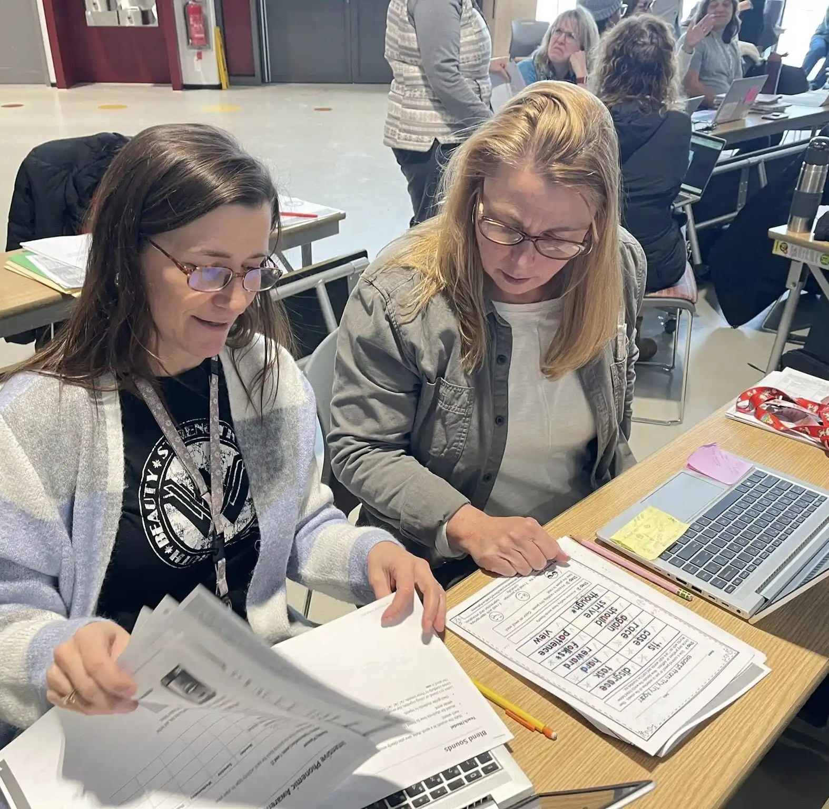
Co-Teaching
Grafenwoehr Elementary School
MARGARET BALLINGER
Multilingual Learner Teacher
https://grafenwoehres.dodea.edu

Slide 2
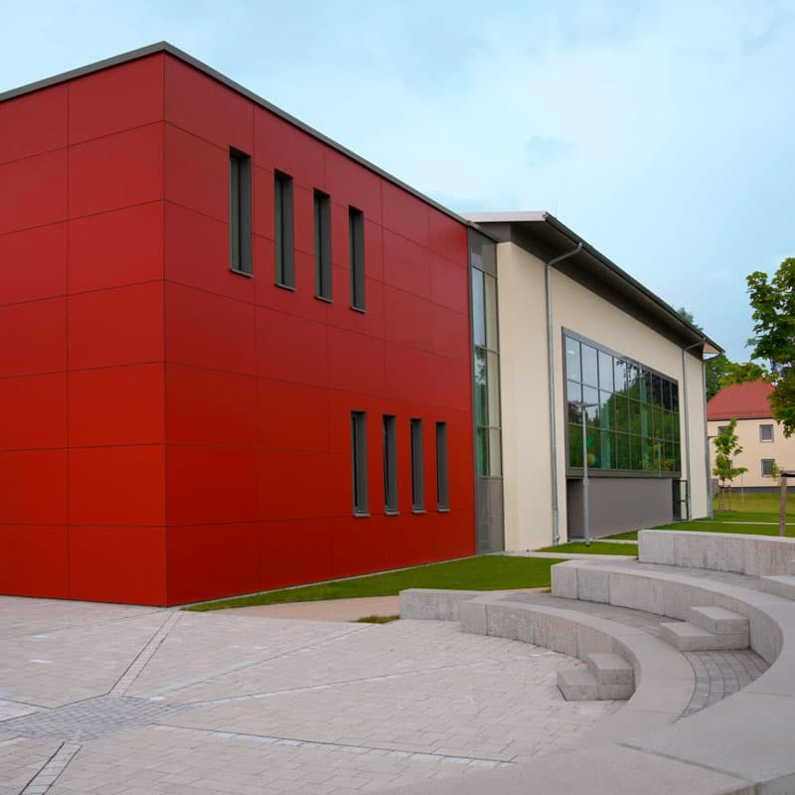
Outcomes
Today, you will…
1
Name and describe the 6 co-teaching models
Identify the benefits of station teaching and parallel teaching
Understand your role and responsibilities as a co-teacher
Co-plan a lesson using station or parallel teaching and apply co-planning questions to an upcoming lesson
2
3
4
5

Slide 3
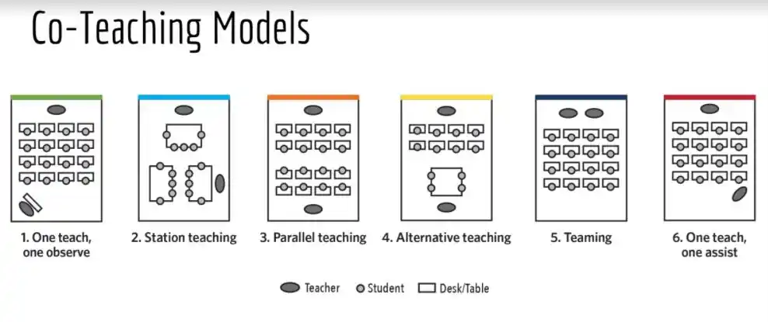
Co-Teaching Models
6

Slide 4
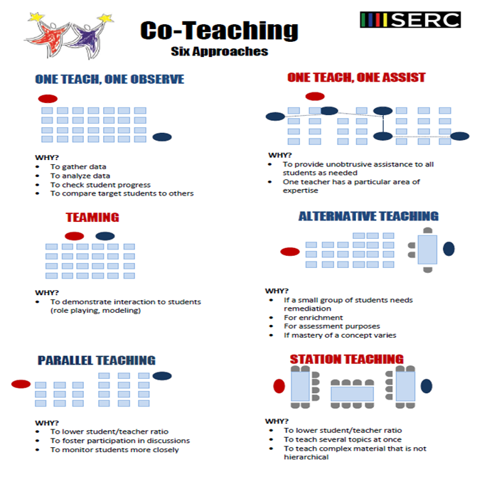
Co-Teaching Models
6

Slide 5
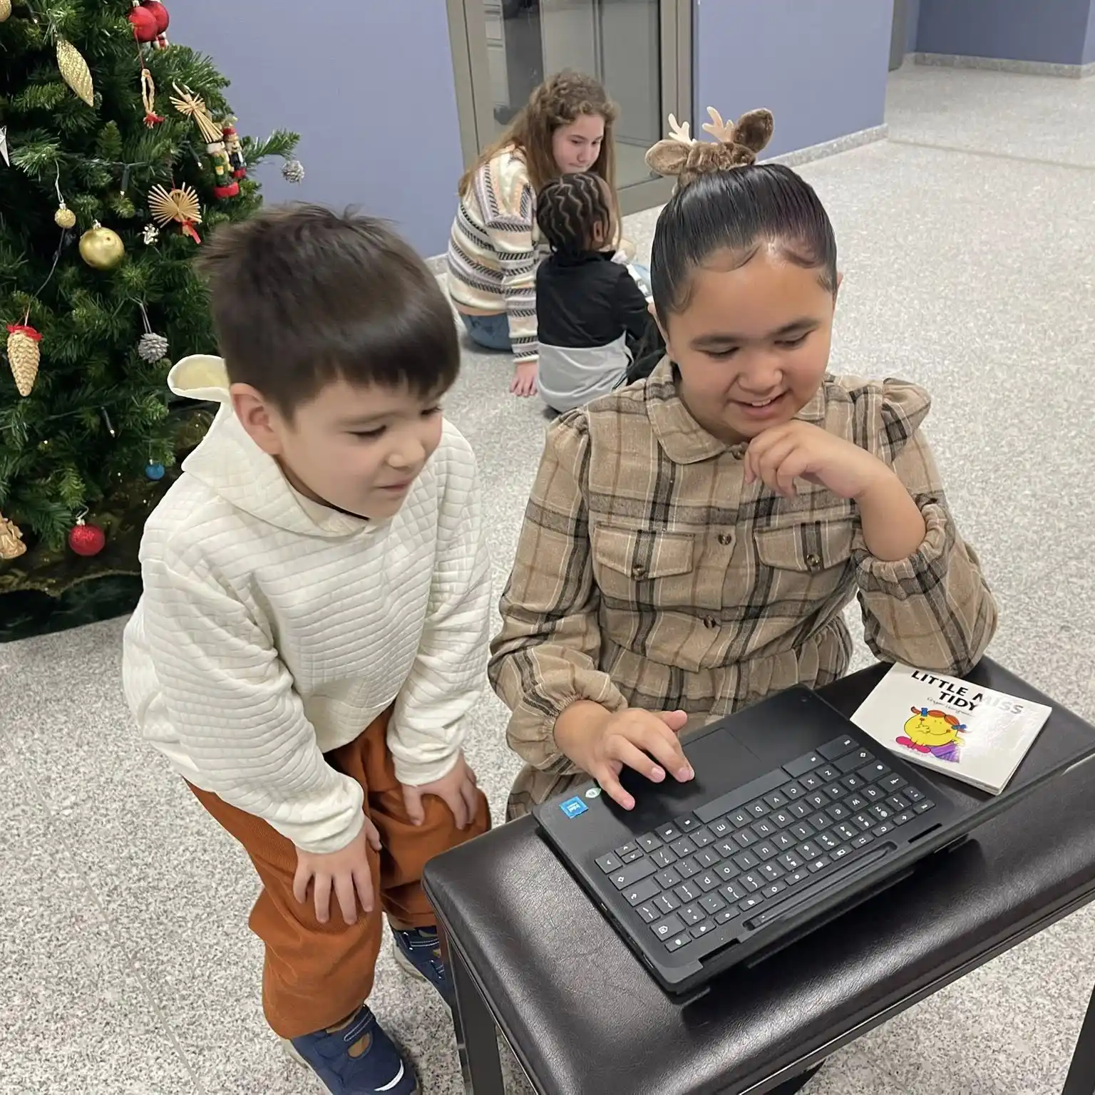
Co-teaching
is like ____________.

Slide 6
Today’s Focus:
1. Station
2. Parallel

Slide 7
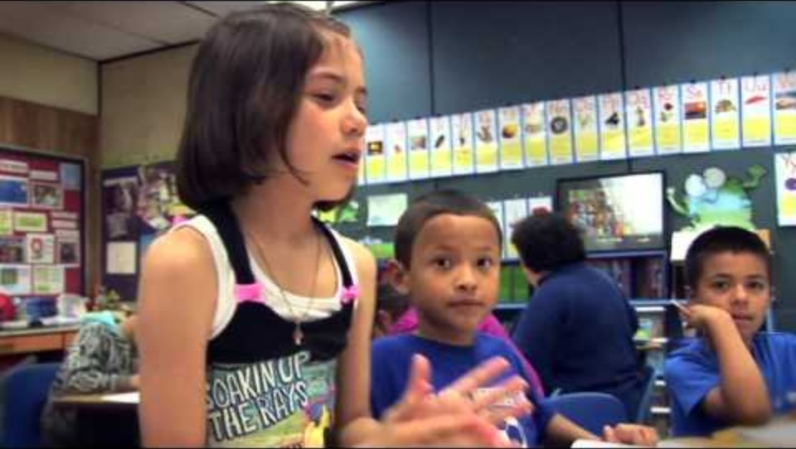
Video: Station Teaching

Slide 8
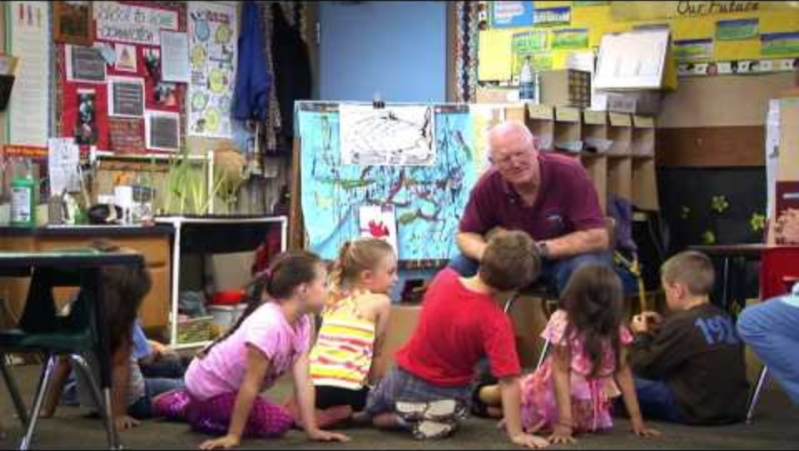
Video: Parallel Teaching

Slide 9
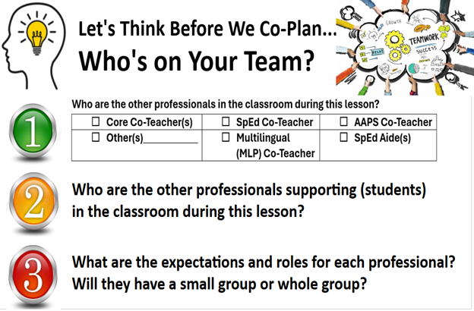

Slide 10
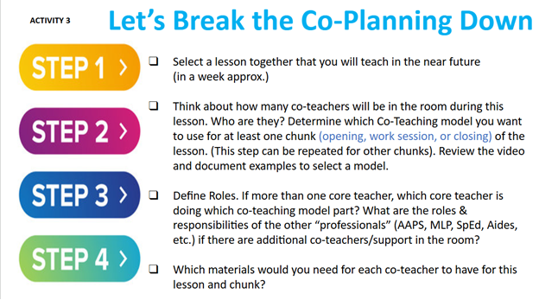

Slide 11
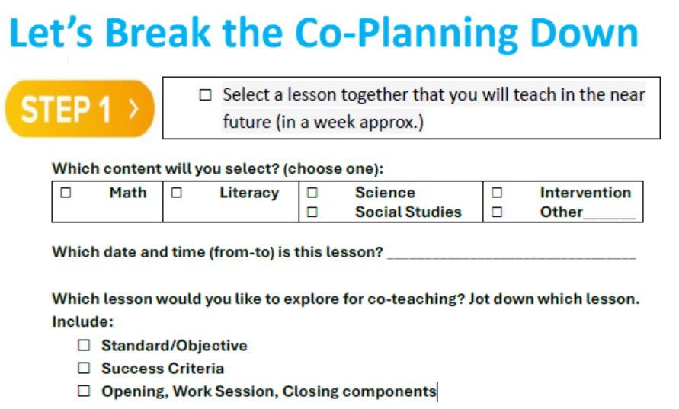

Slide 12
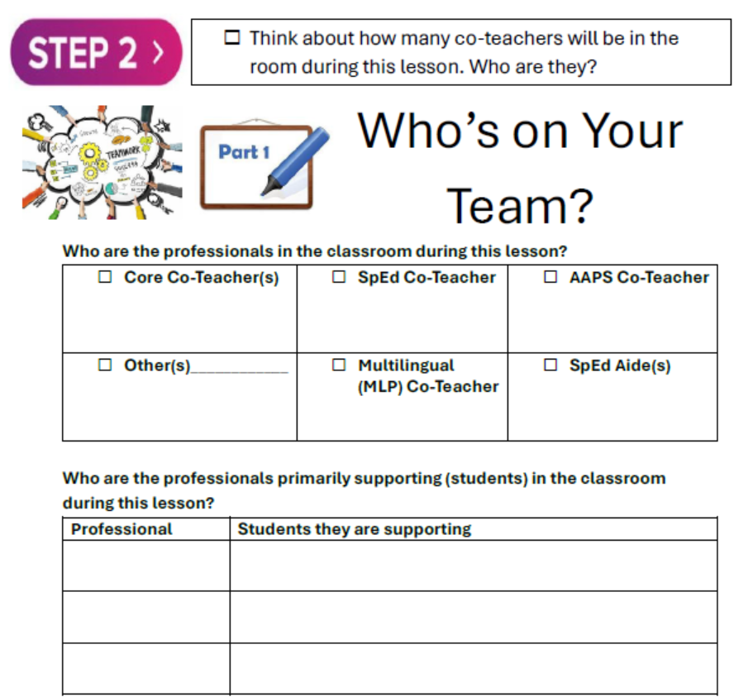

Slide 13
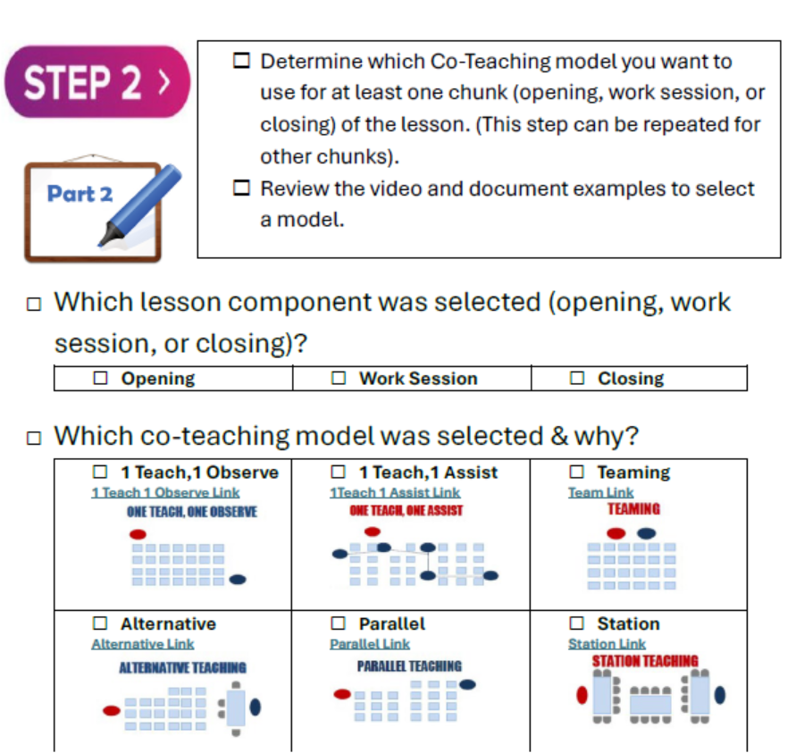

Slide 14
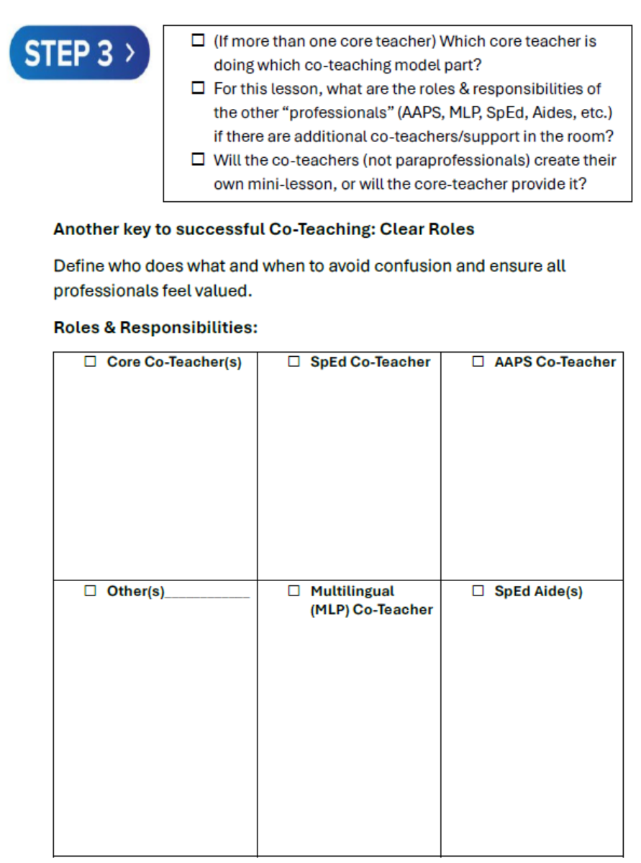

Slide 15
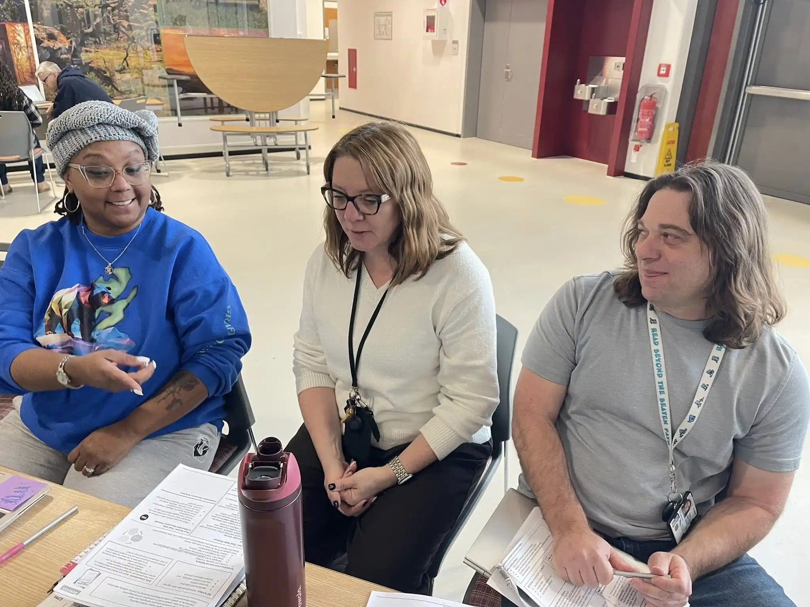
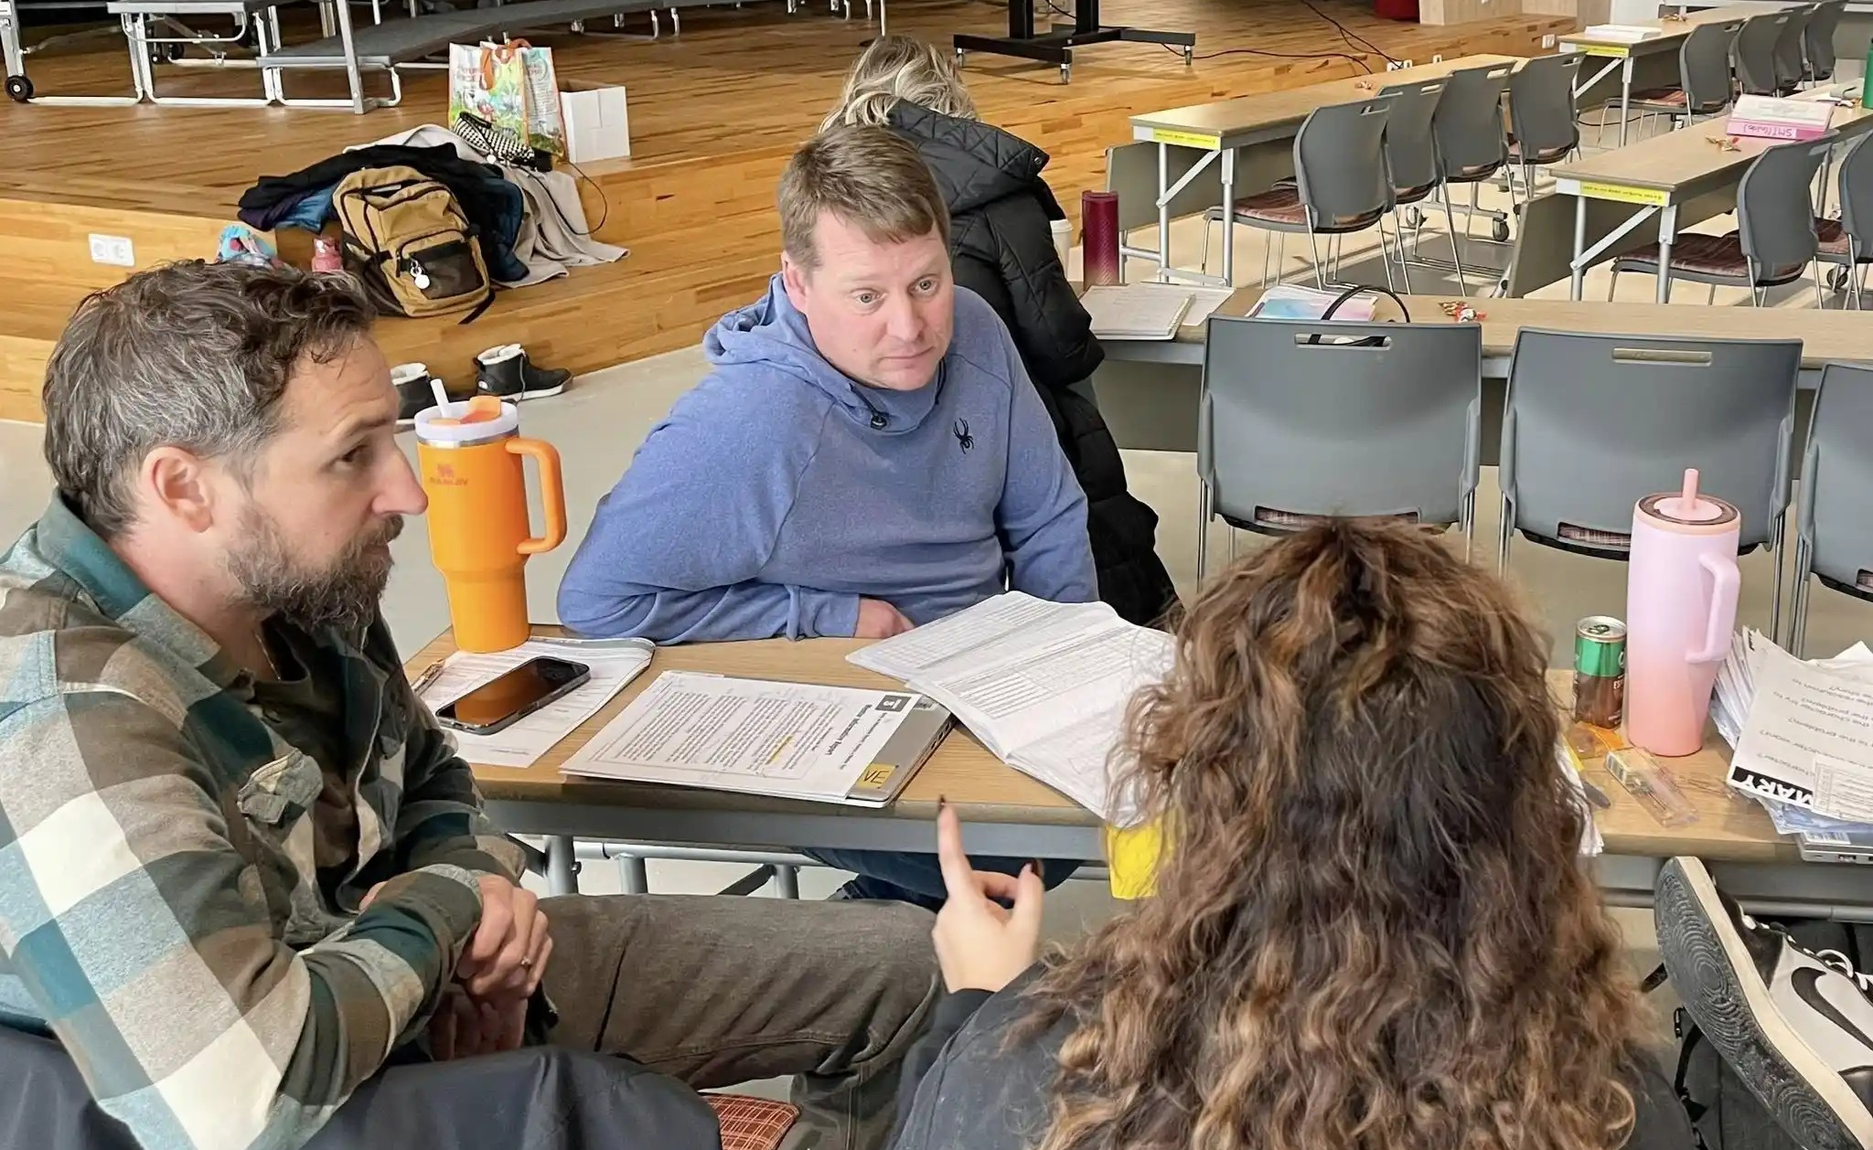
Review
Today, you should…
1
Know the schedule of your co-teachers
Which days/times are they in your classroom?
Meet once a week to plan upcoming lessons and answer co-teaching lesson planning questions together
2
3

Slide 16
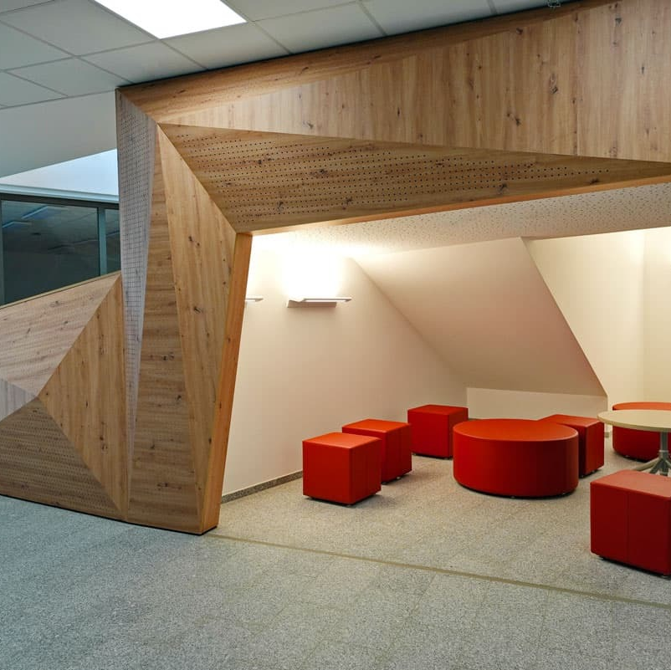
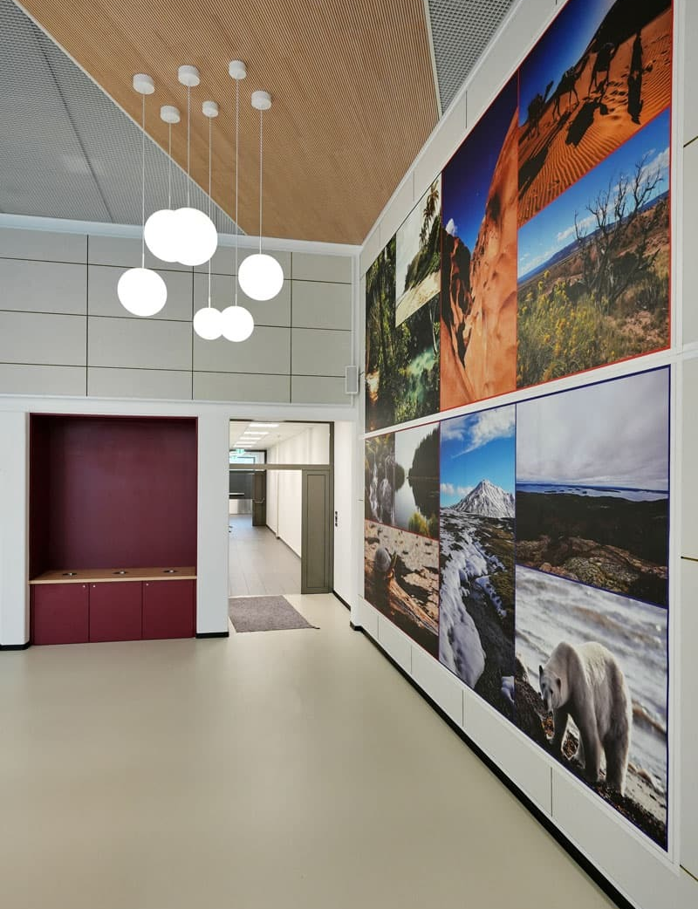
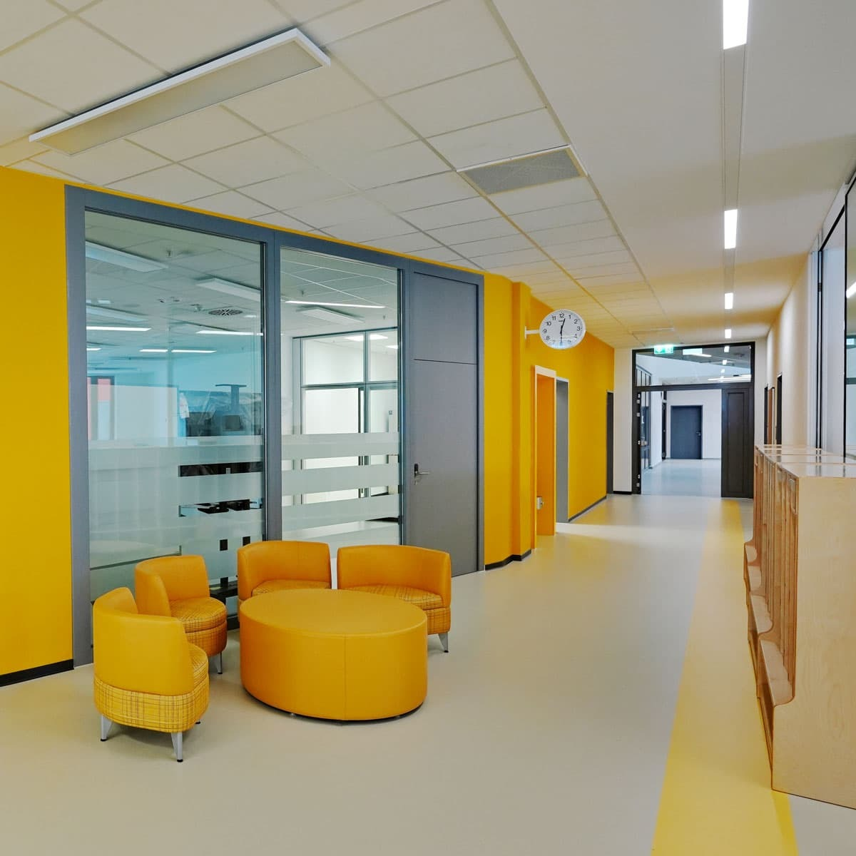
Questions?

